Slide 1
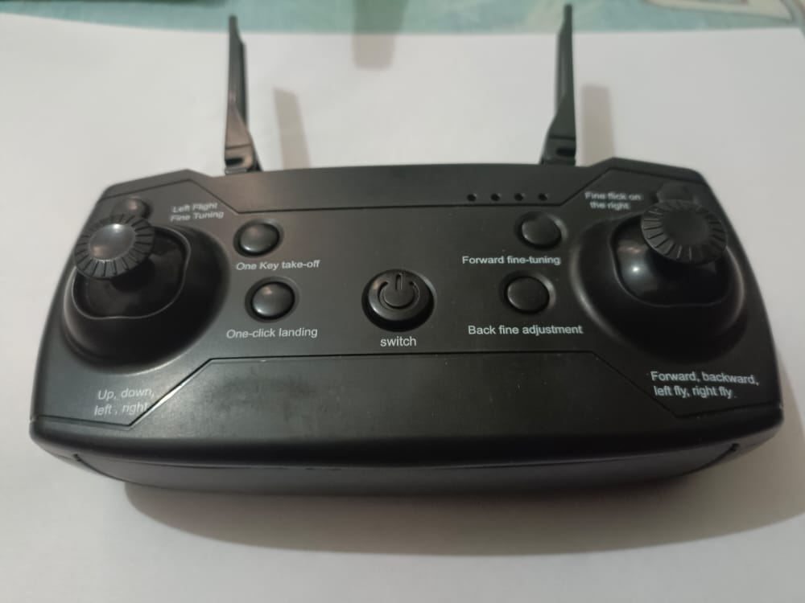
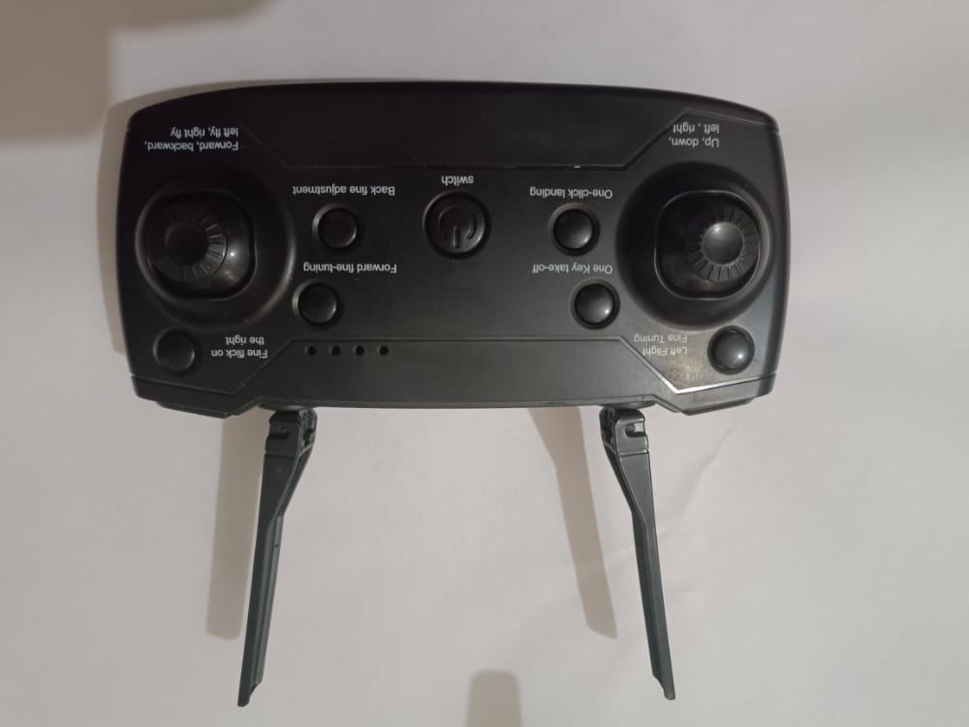

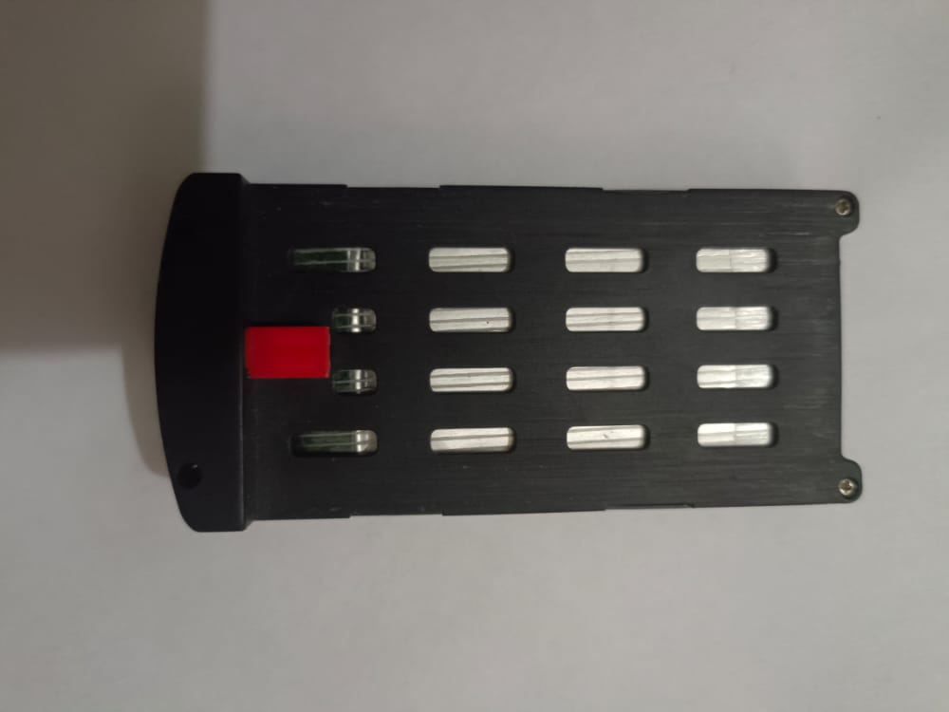


Controller
It’s operate the drone to navigate, launch, and land the aircraft
Controllers communicate with the drone using radio waves, such as Wi-Fi.

